Slide 1
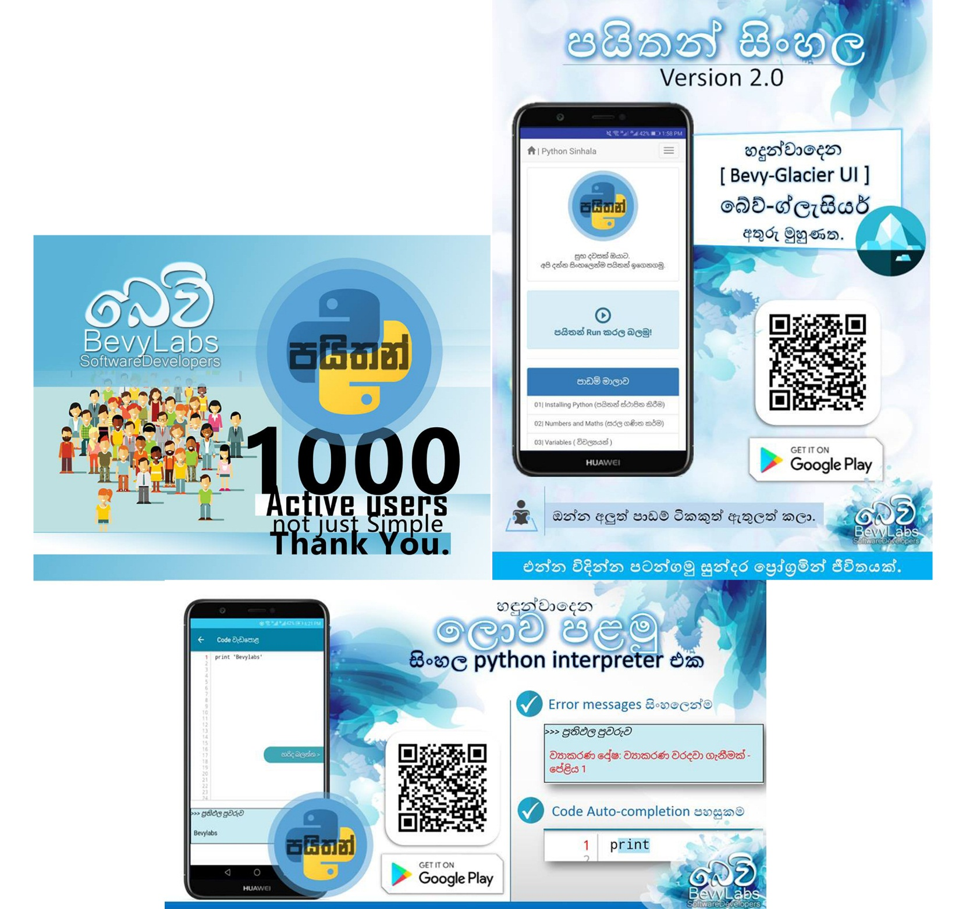
Project Name: Python Sinhala
Used Technologies: Android Studio, Java, HTML , Bootstrap
Description: An android application that helps people to startup with programming. It has over 5000 downloads through the Google Playstore.
Project URL : play.google.com/store/apps/details?id=bevylabs.buddhika.pythonsinhala

Slide 2
Project Name: “Amba Yaluwa” – The Concentration Device
Used Technologies: Arduino ,NodeMCU, C , Electronics
Description: A concentration device that based on psychology techniques (Color psychology , Pomodoro technique)
Project URL : 3rd Place ( Bronze Medal ) in Applied Science & Technology “Sahasak Nimeum” National Exhibition and Competition 2018 An Exhibition Organized by Sri Lanka Inventors Commission.
Merit Award - National Best Quality ICT Awards (NBQSA) 2018 Organized by British Computer Society (BCS) – The Chartered Institute for IT.
Finalist IEEE SS12 MakerFair South Asian Exhibition and Competition 2018 An innovations exhibition Organized by IEEE

Slide 3
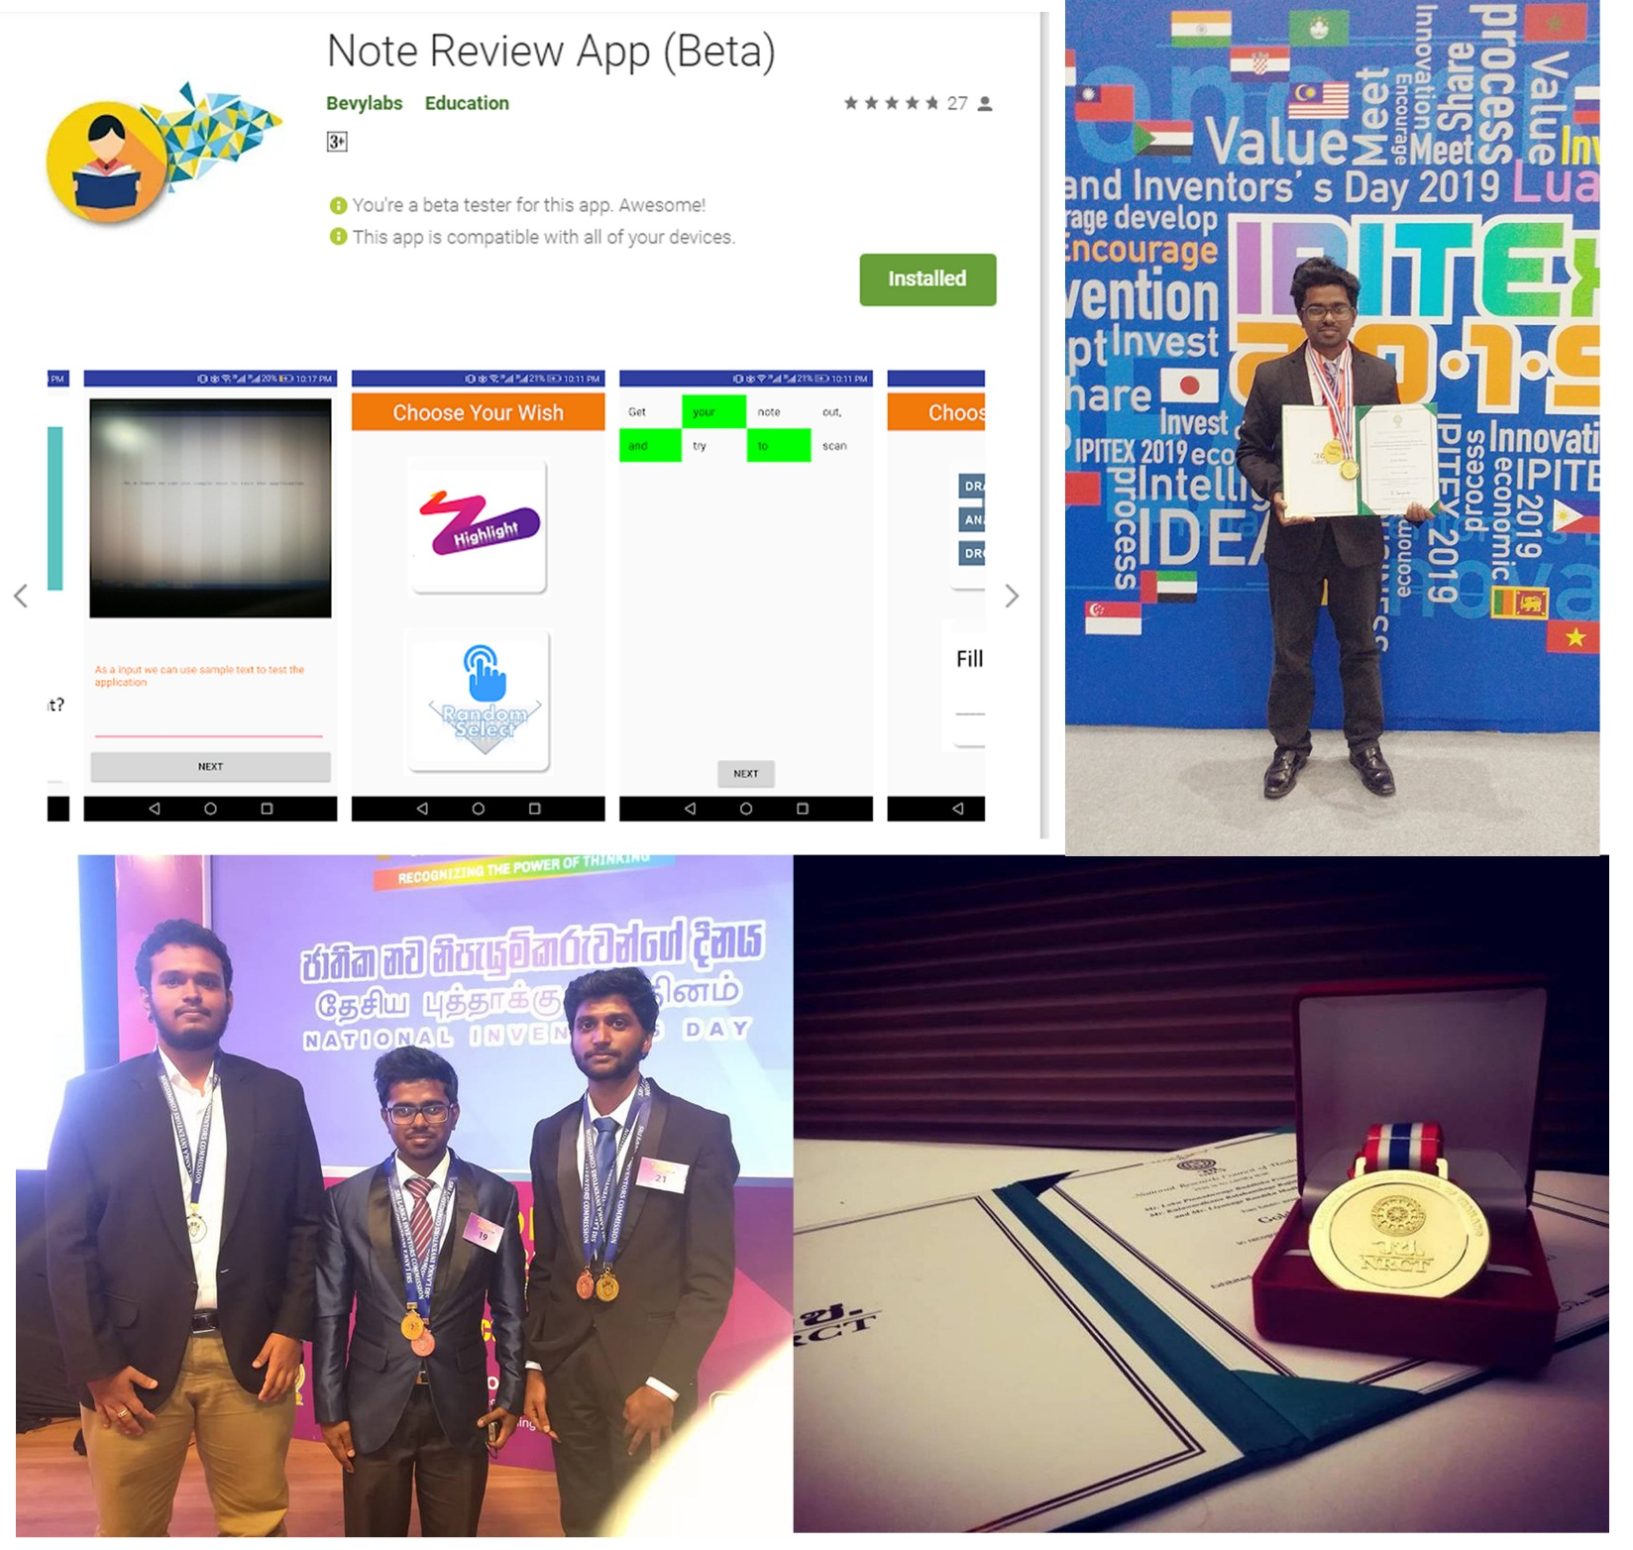
Project Name: NoteReview App
Used Technologies: Android Studio, Java, GoogleVisionAPI
Description: A solution for review notes and can evaluate the user in less than in 2mins.
Awards : Gold Medal - IPITEx 2019 (International Exhibition and Competition ) Bangkok International Intellectual Property Invention, Innovation and Technology Exposition.
1st Place ( Gold Medal ) in ICT Category “Sahasak Nimeum” National Exhibition and Competition 2018 An Exhibition Organized by Sri Lanka Inventors Commission
Project URL : play.google.com/store/apps/details?id=com.bevylabs.buddhika.notereview

Slide 4
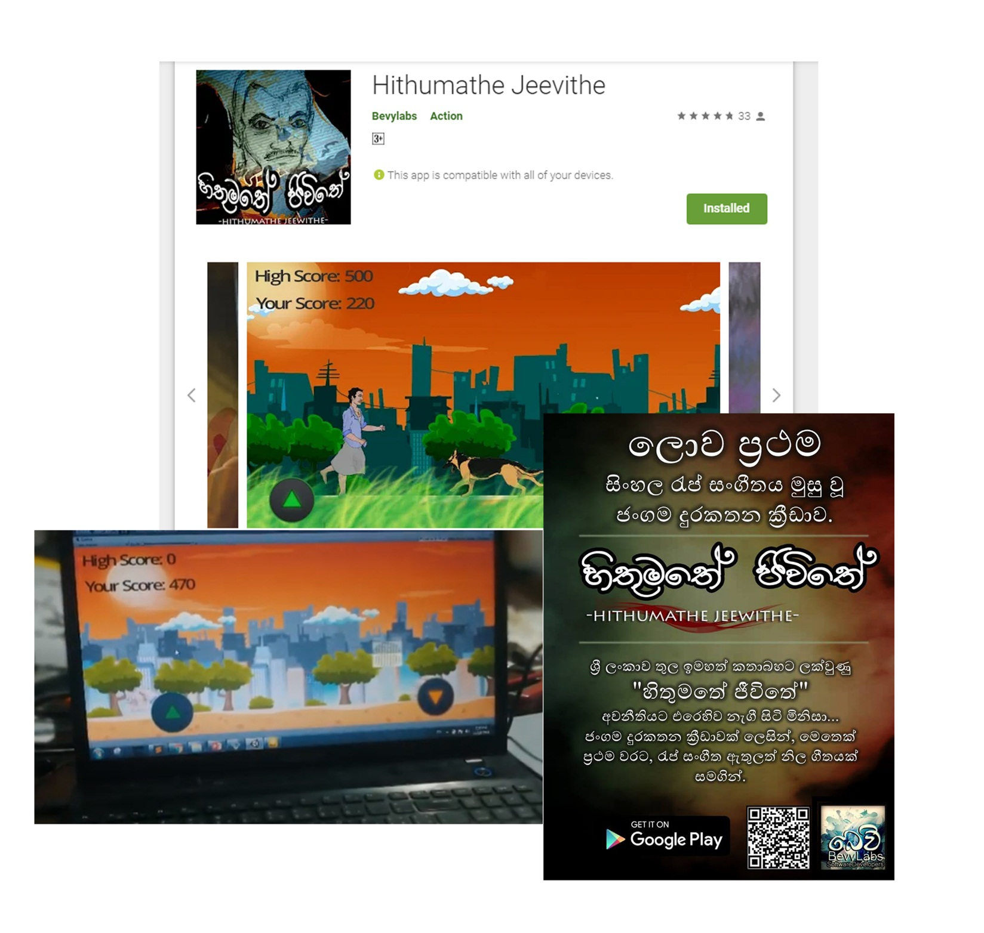
Project Name: Hithumathe Jeevithe – The Android Game
Used Technologies: Unity, Adobe PS, Autodesk SB, FL-Studio.
Description: Sri Lanka’s first game with a rap music. A platformer action game.
Project URL : play.google.com/store/apps/details?id=com.BevyLabs.Hethumathe
Awards : 1 st place UWU GameJam 2018 A Game Hackathon Organized by Mozilla Campus Club - UWU.

Slide 5
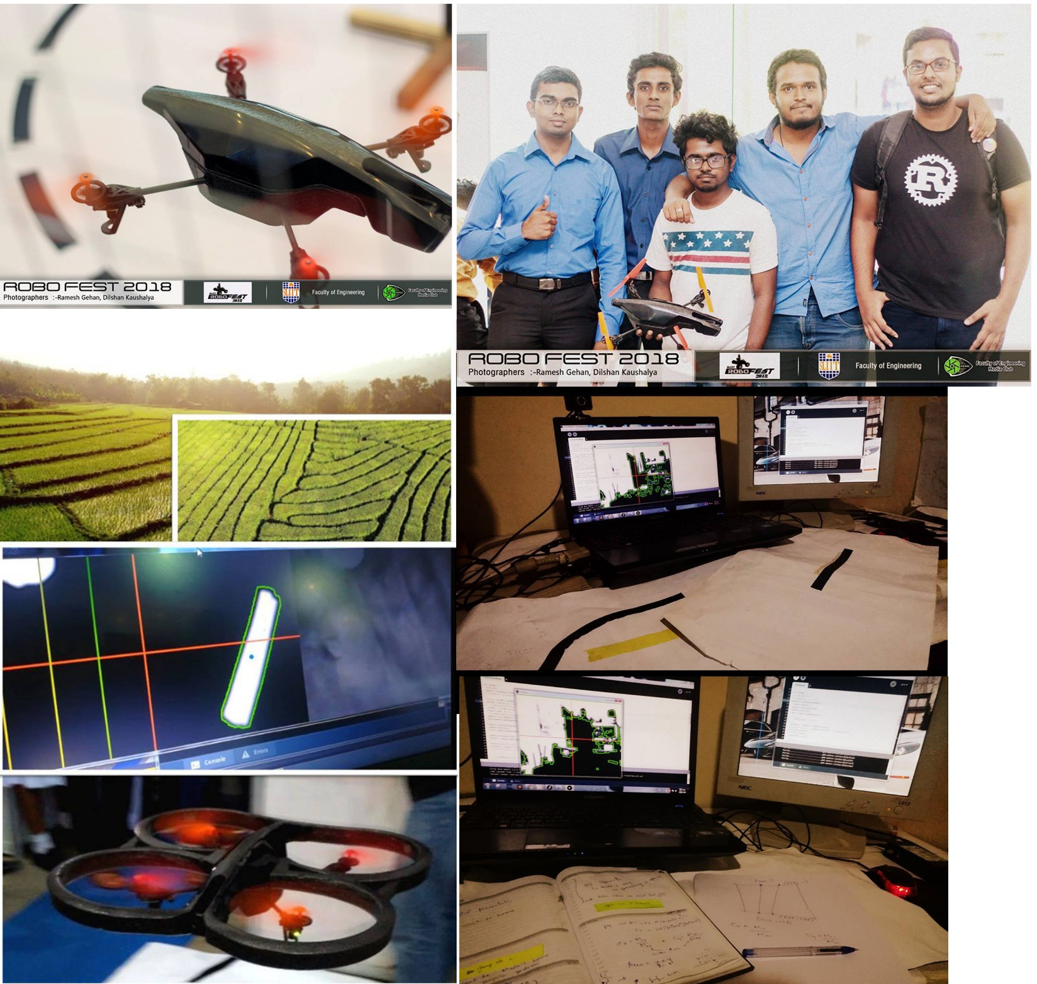
Project Name: “BevyLabsFlyBee”
Used Technologies: Linux kernel, Python, OpenCV, Processing
Description: An autonomous drone that can fly using detecting lines.
Project URL :

Slide 6
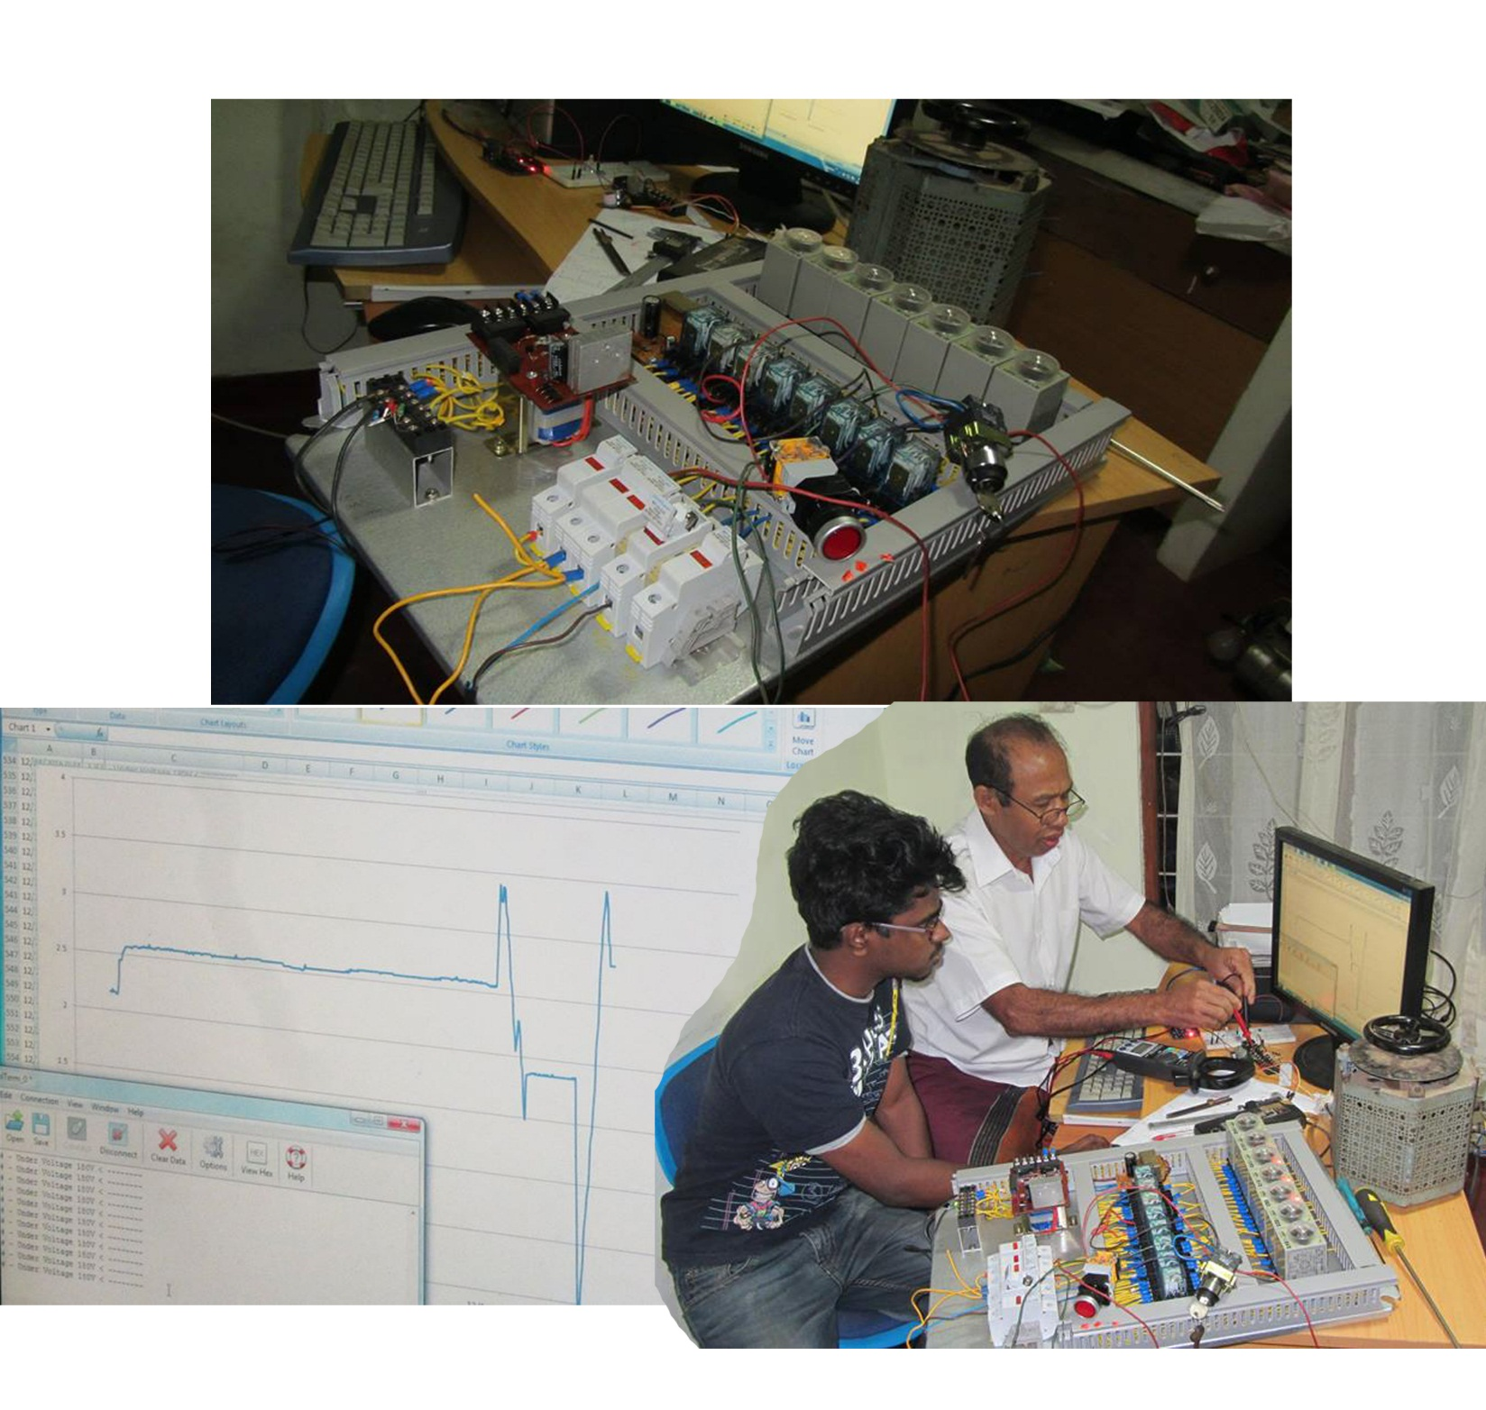
Project Name: Project “GenACMS”
Used Technologies: Arduino, C, Electronics, MSExcel.
Description: A solution for measuring/indicating A/C voltages levels with real-time monitoring system.
Project URL :

Slide 7
Project Name: Project “Vibes”
Used Technologies : Android, Firebase, GoogleVisionAPI, MSExcel
Description : A mobile solution for who want to mark attendance of a large number of people in less amount of time.
Project URL :

Slide 8
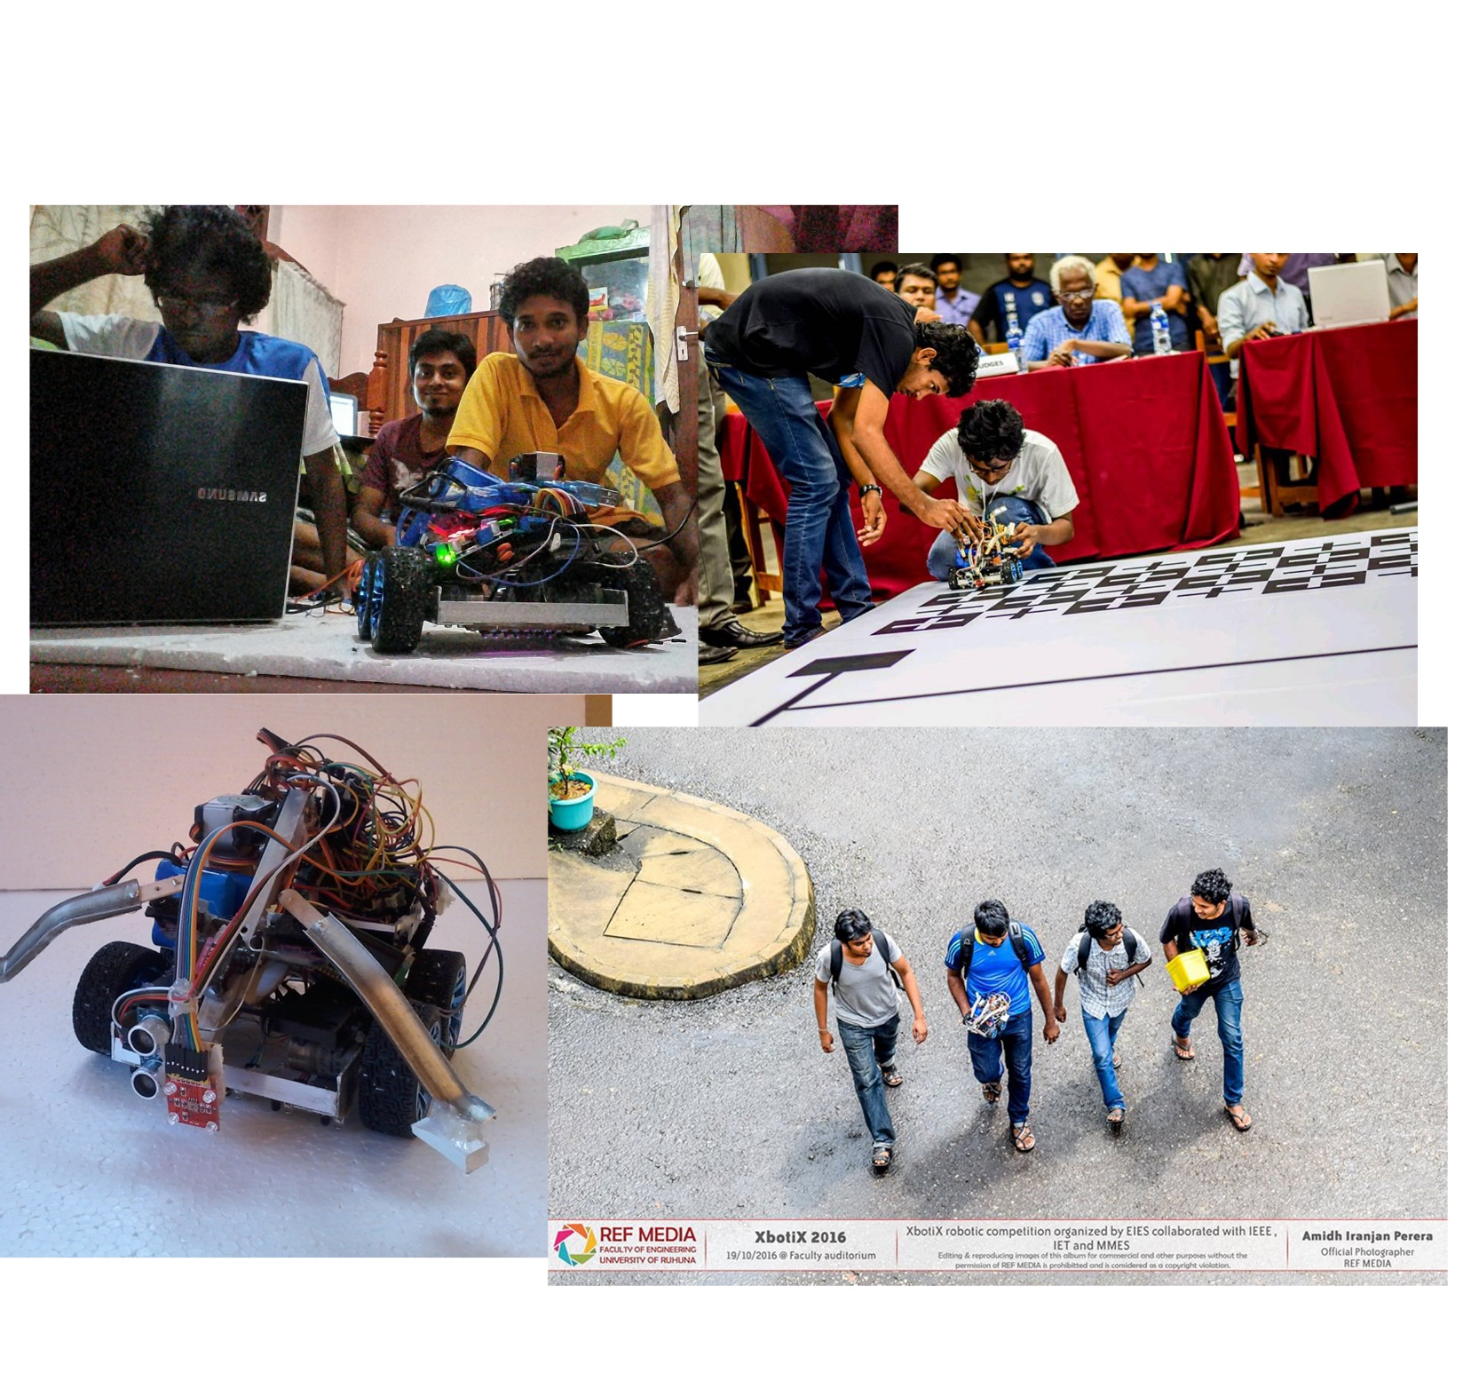
Project Name: Project “Vibes”
Used Technologies : Android, Firebase, GoogleVisionAPI, MSExcel
Description : A mobile solution for who want to mark attendance of a large number of people in less amount of time.
Project URL :

Slide 9
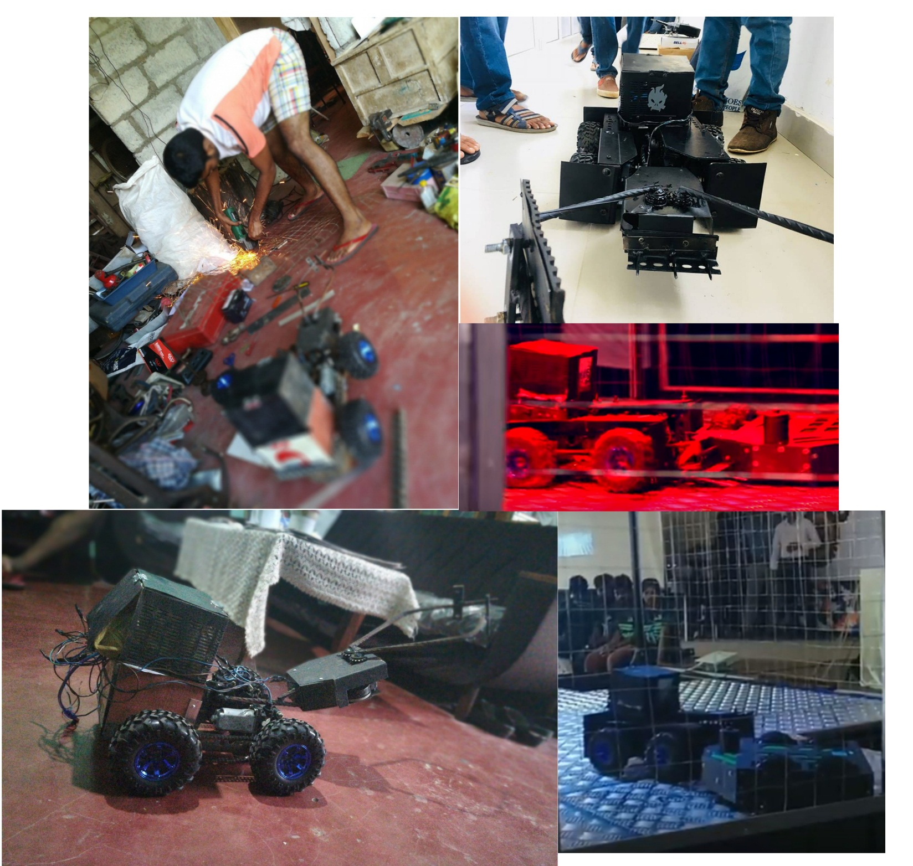

Slide 10
